Slide 1


Presentation On Web Programming
Submitted By:
Anil Shrestha (Team Leader)
Iswar Sharma
Suresh Pokhrel
Nehal Kalbande
Arjun Kharel

Slide 2
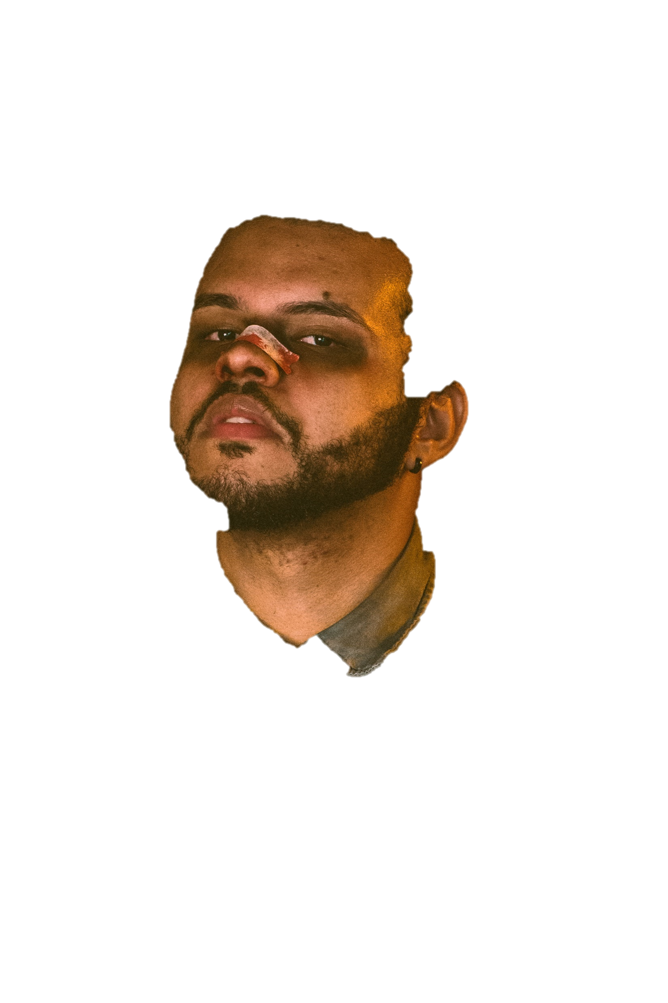
Theme Topic: Celebrity Page The Weeknd (Canadian singer)
Abel Makkonen Tesfaye, known professionally as the Weeknd, is a Canadian singer, songwriter and actor. Known for his sonic versatility and dark lyricism, his music explores escapism, romance, and melancholia, and is often inspired by personal experiences.

Slide 3
About Project
Project is based on a Canadian singer, we have created a website as celebrity page for The Weeknd.
Website is consist of One Home page with separate section Like About, Photos, Header, Footer, Videos and a Contact Us page.
We used all possible HTML tags with external CSS.
A subscribe option is also there where fans can provide Email address and will get email update.

Slide 4
Screenshot of Website
https://letsroam.github.io/Final_Project/

Slide 5

Home Page

Slide 6
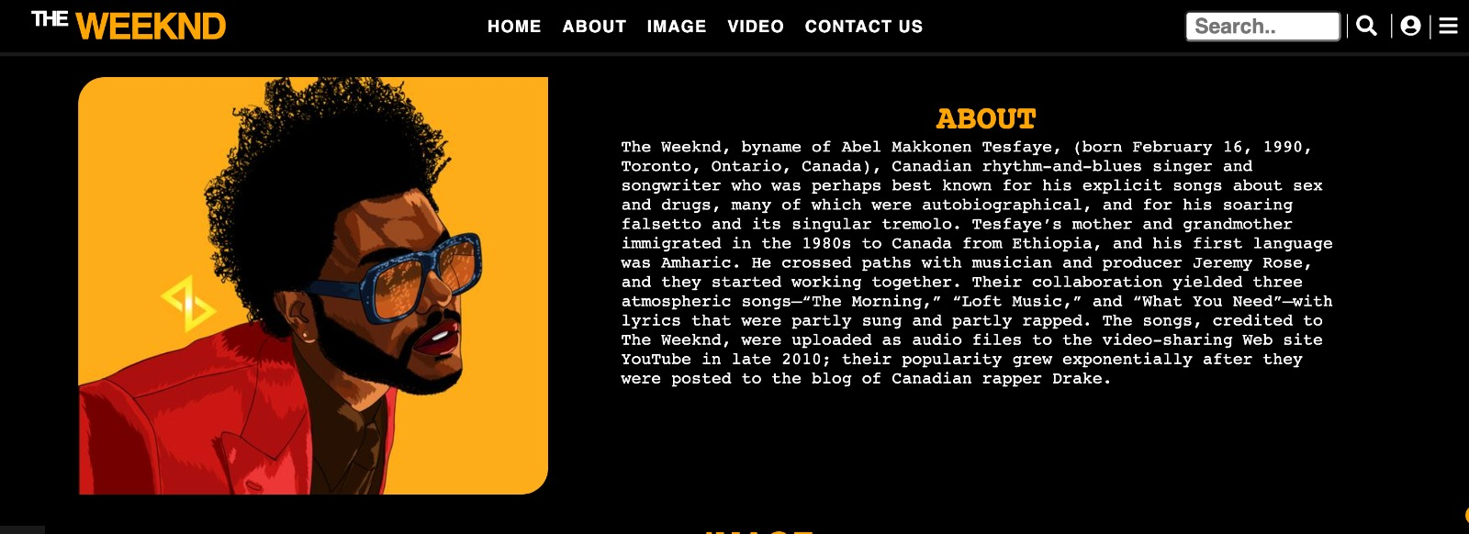
About Section

Slide 7
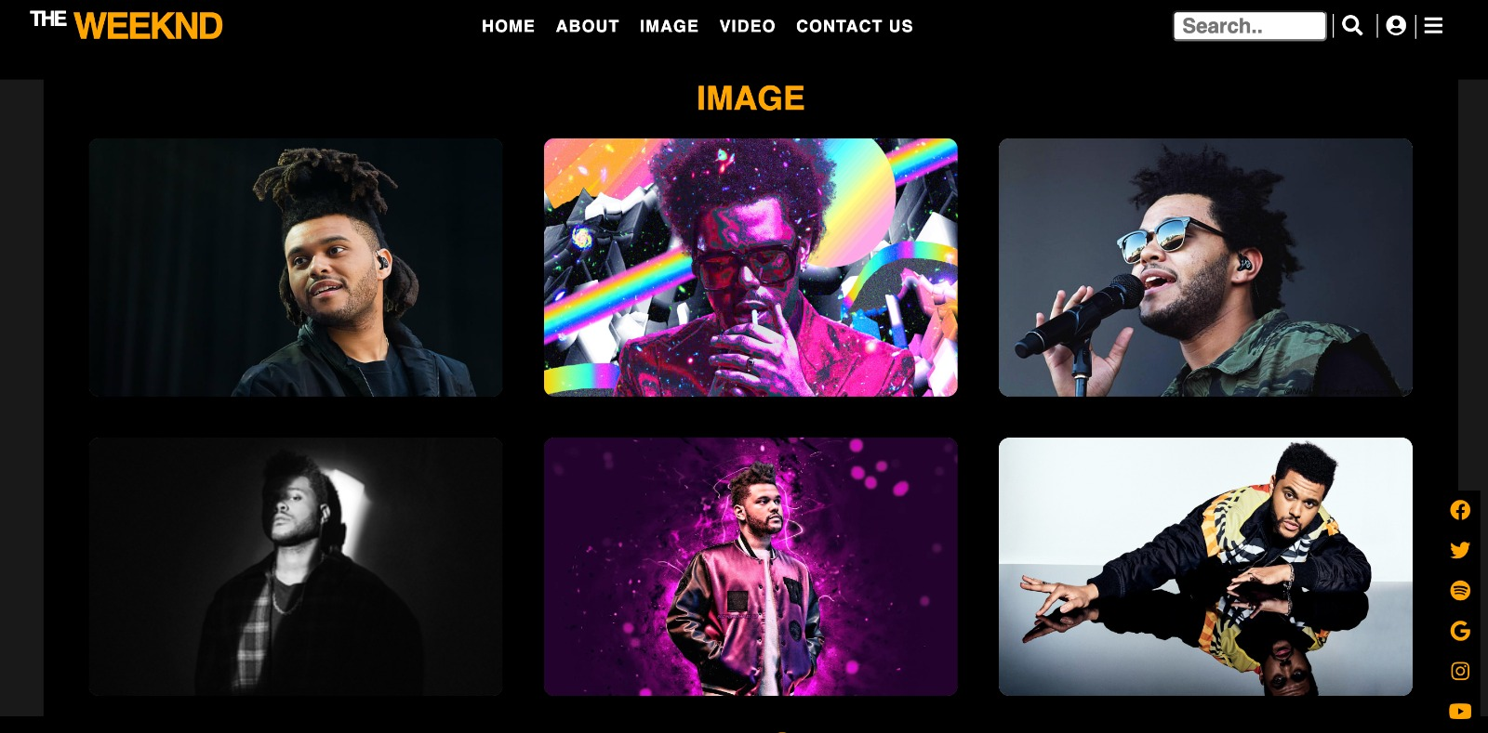
Image Section

Slide 8
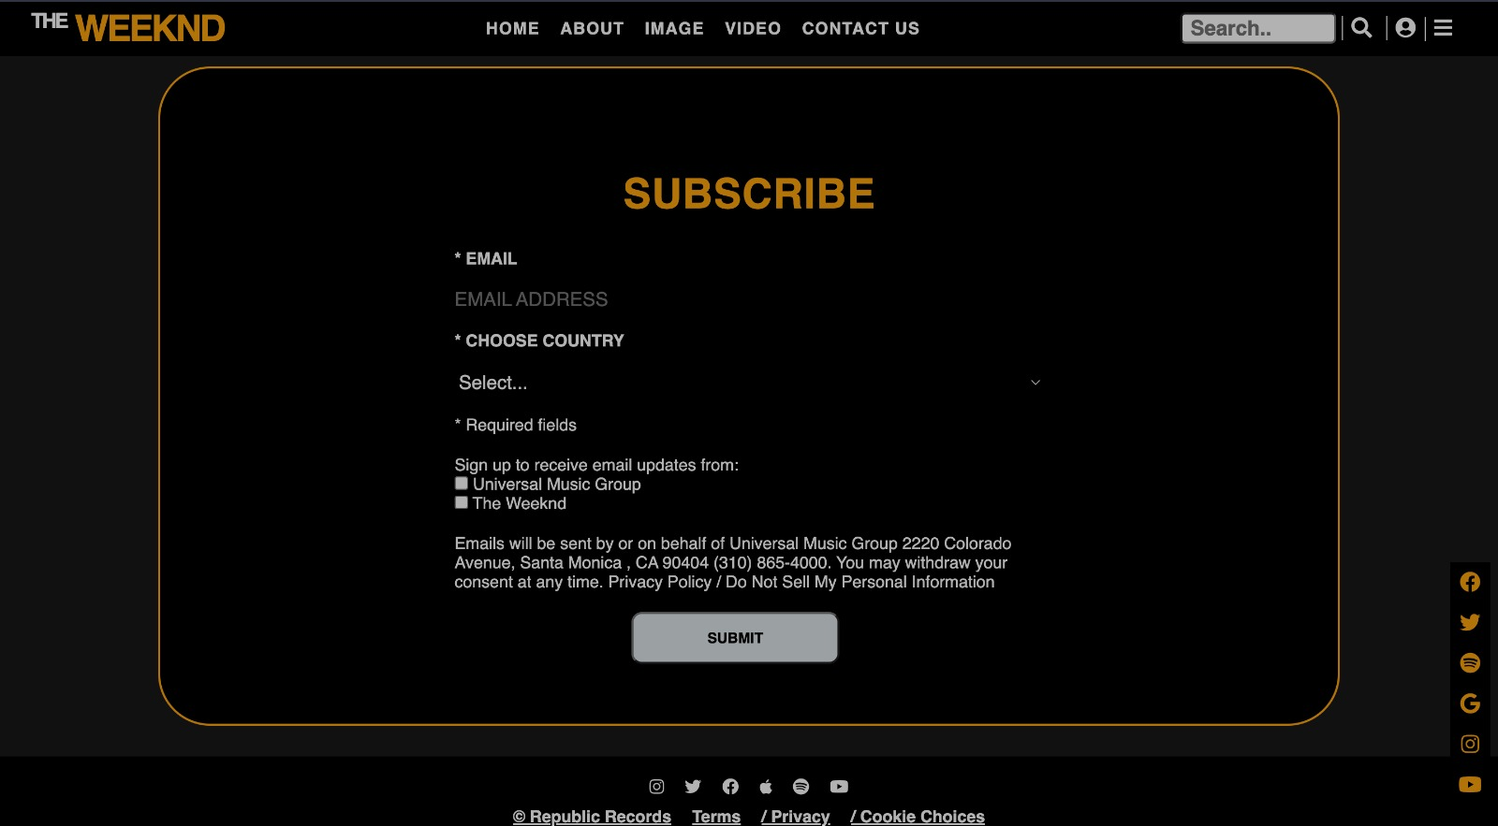
Footer

Slide 9
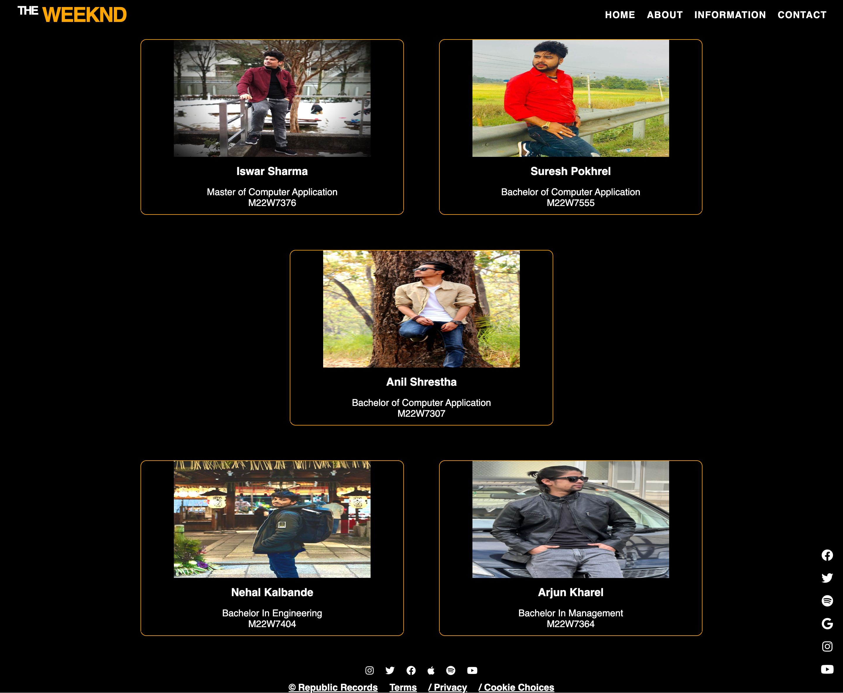
Contact Us Page

Slide 10
Website Improvement
There are more option we can add in this website like Login page for fans and after Log in they will get a chance to access premium content of celebrity.
This is dynamic website with no backend.

Slide 11
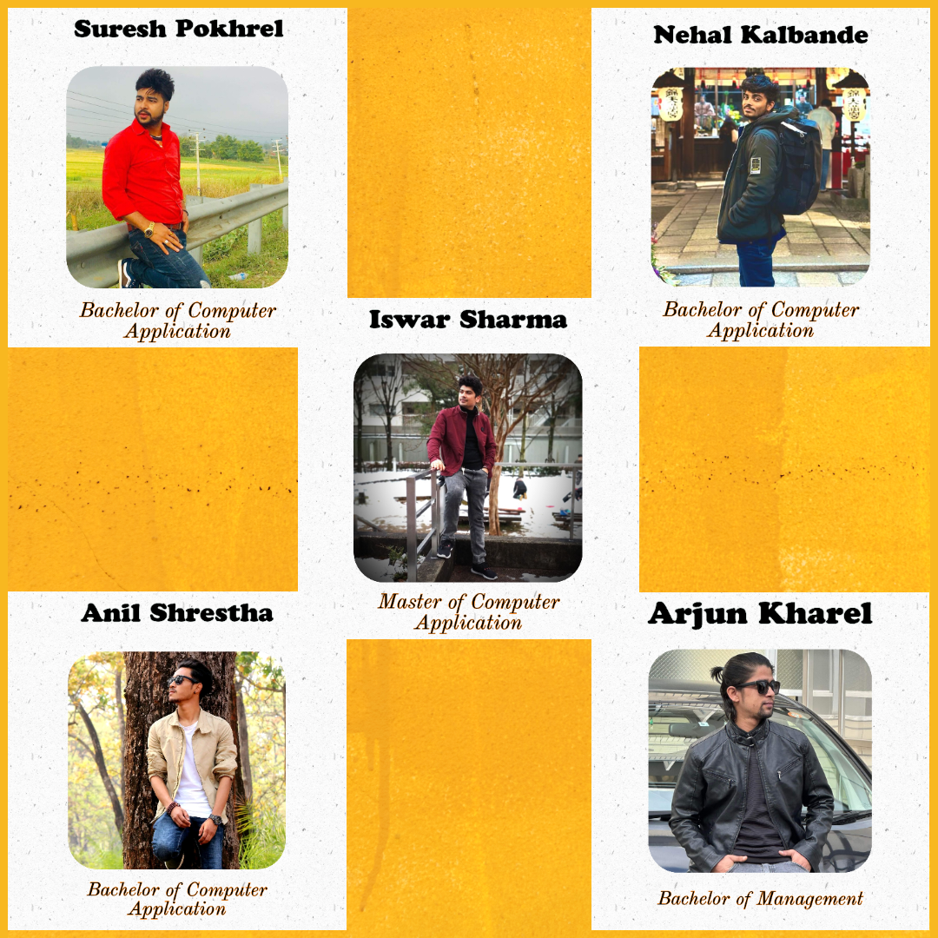
Thank
Thank
You
You

